Slide 1
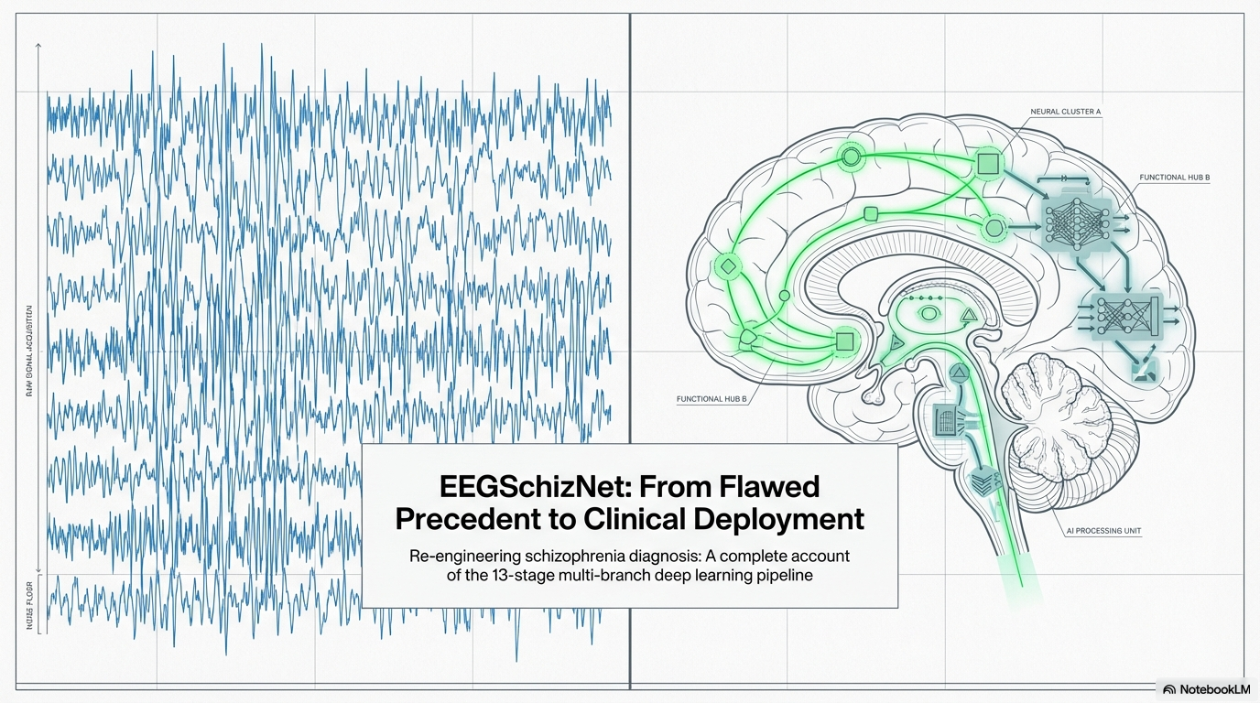

Slide 2
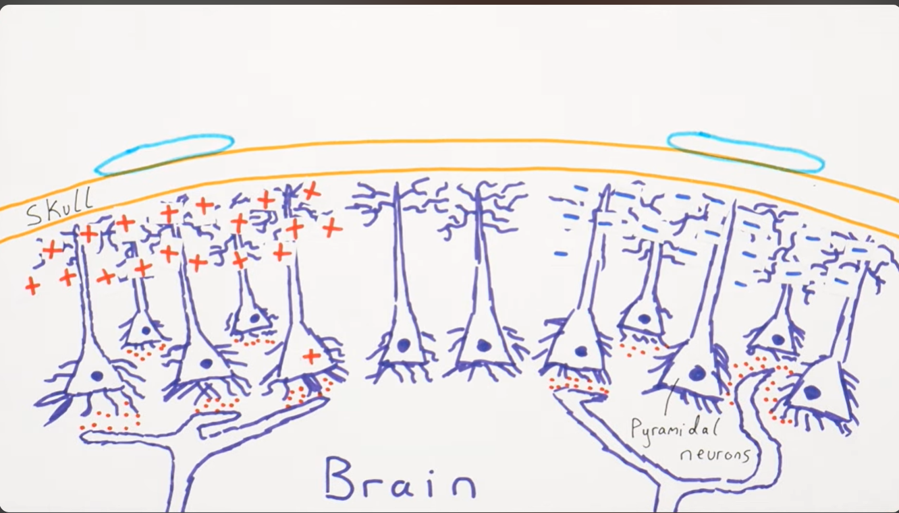
EEG – Electroencephalogram
The brain constantly generates electrical activity through millions of firing neurons. EEG (Electroencephalography) captures this activity by placing small electrodes on the scalp, which detect tiny voltage signals travelling outward from the brain.
The key source of these signals are pyramidal neurons in the cortex — when thousands of them fire together, they create a detectable electrical field strong enough to reach the scalp.
These signals appear as brainwaves on screen, helping doctors diagnose conditions like epilepsy, sleep disorders, and monitor overall brain health — all non-invasively.
Think of it as listening to a crowd — one voice is silent, but thousands together are heard clearly

Slide 3
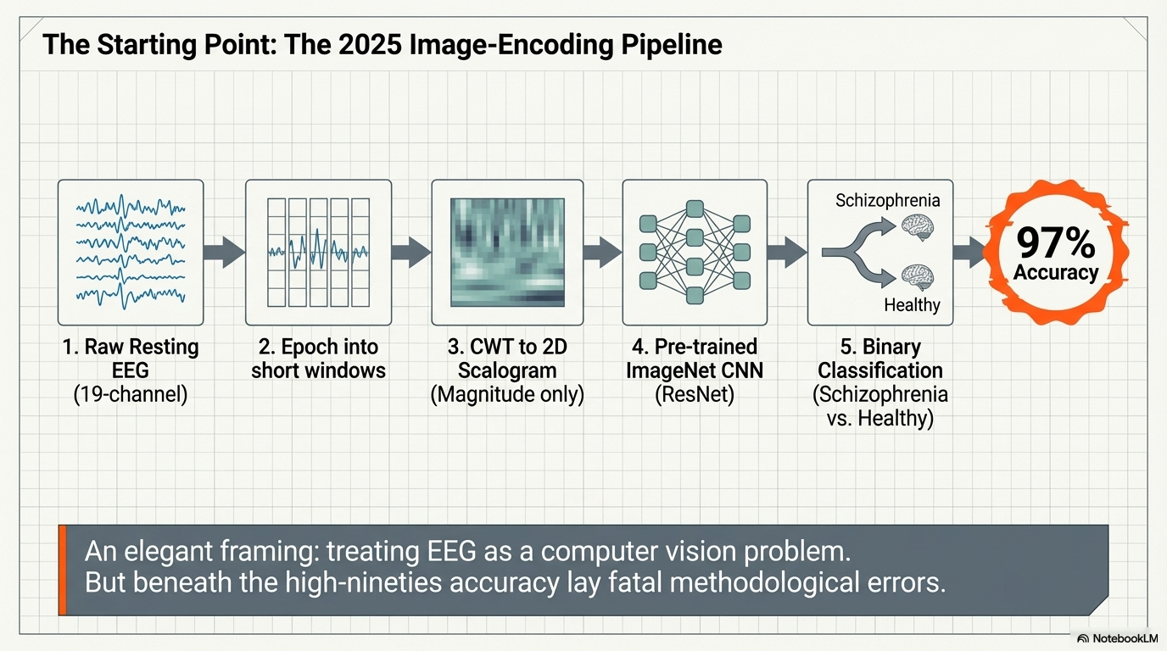

Slide 4
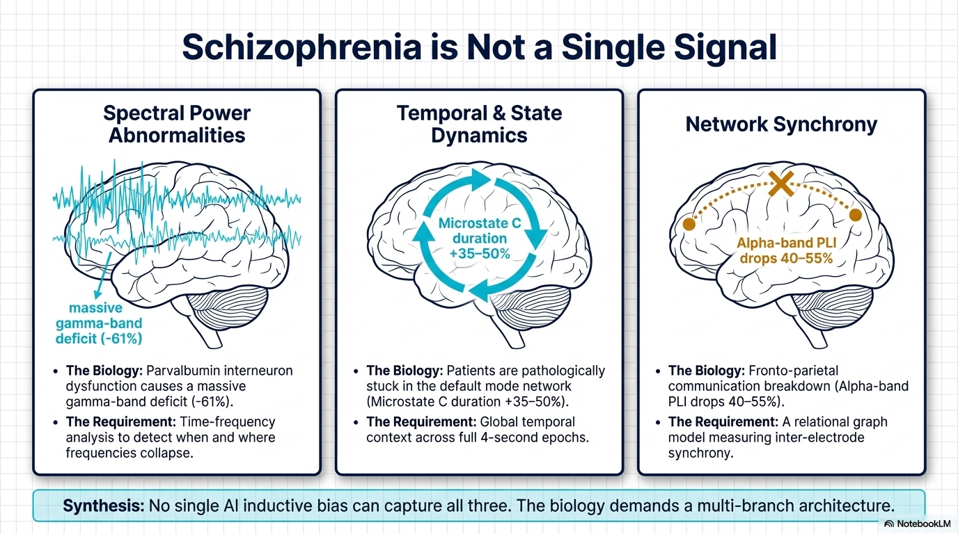

Slide 5
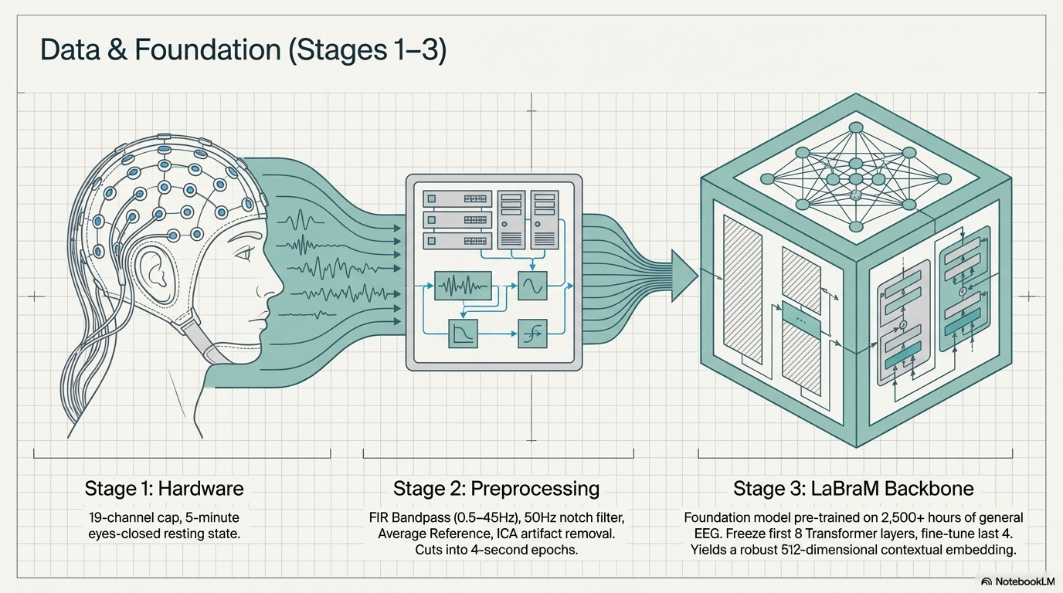

Slide 6
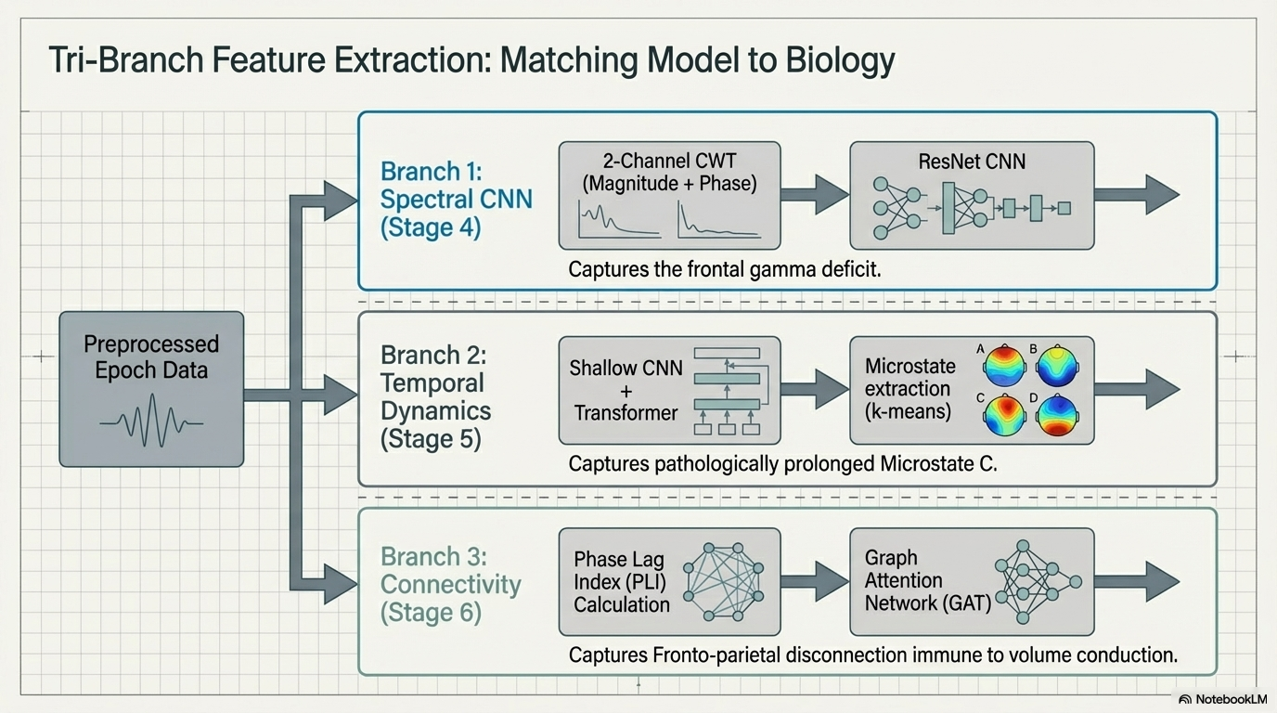

Slide 7
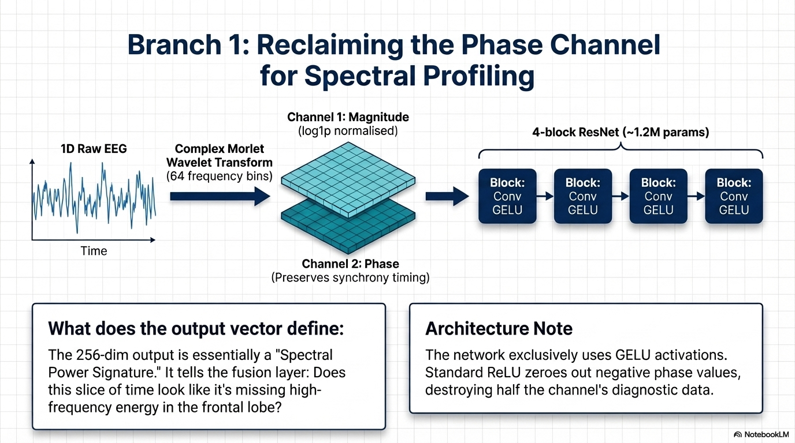

Slide 8
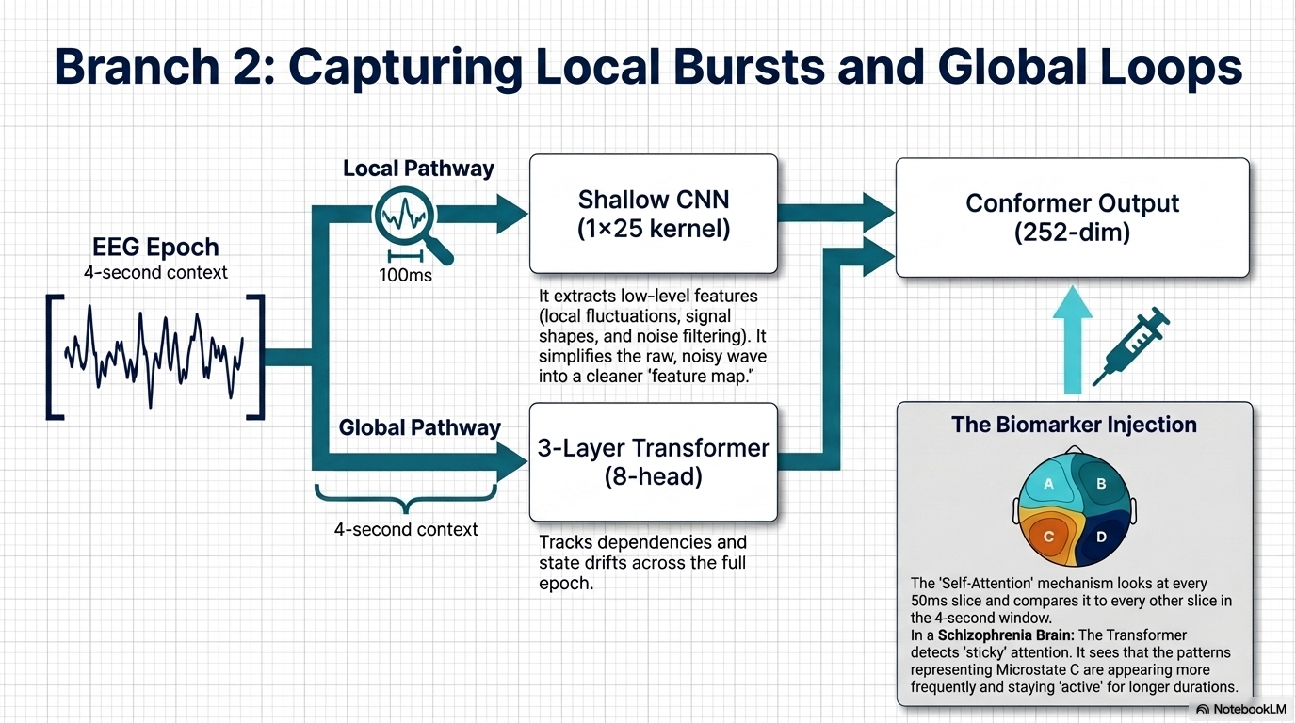

Slide 9
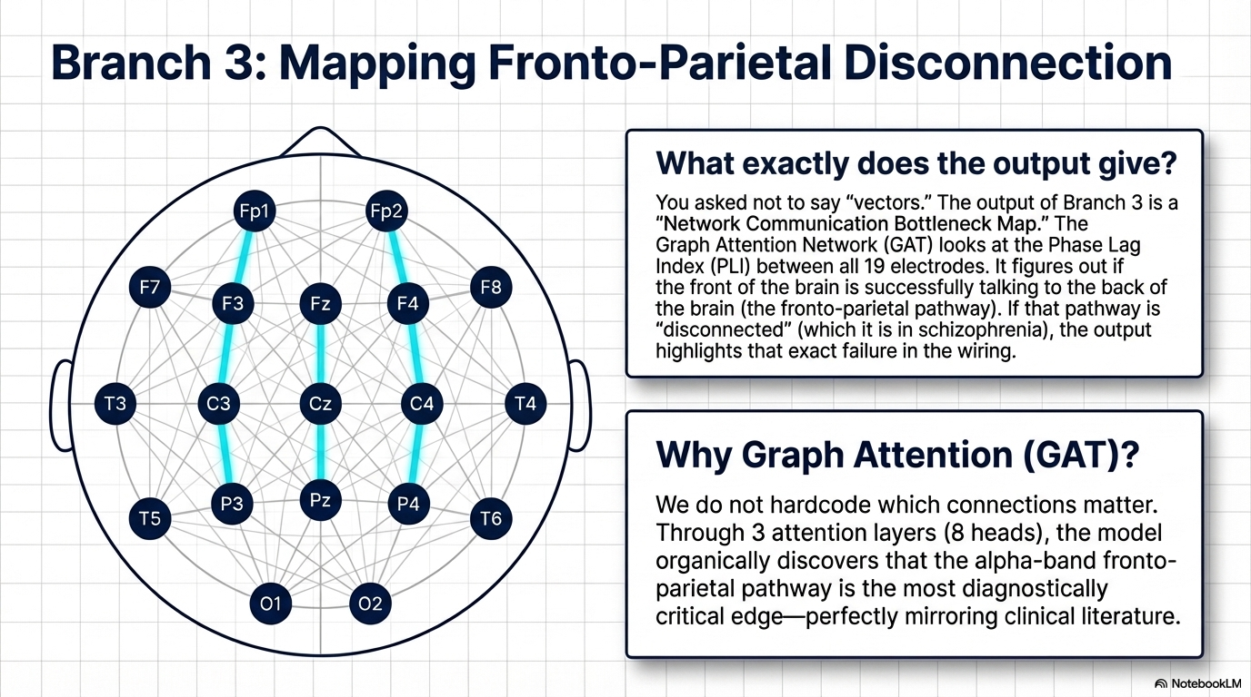

Slide 10
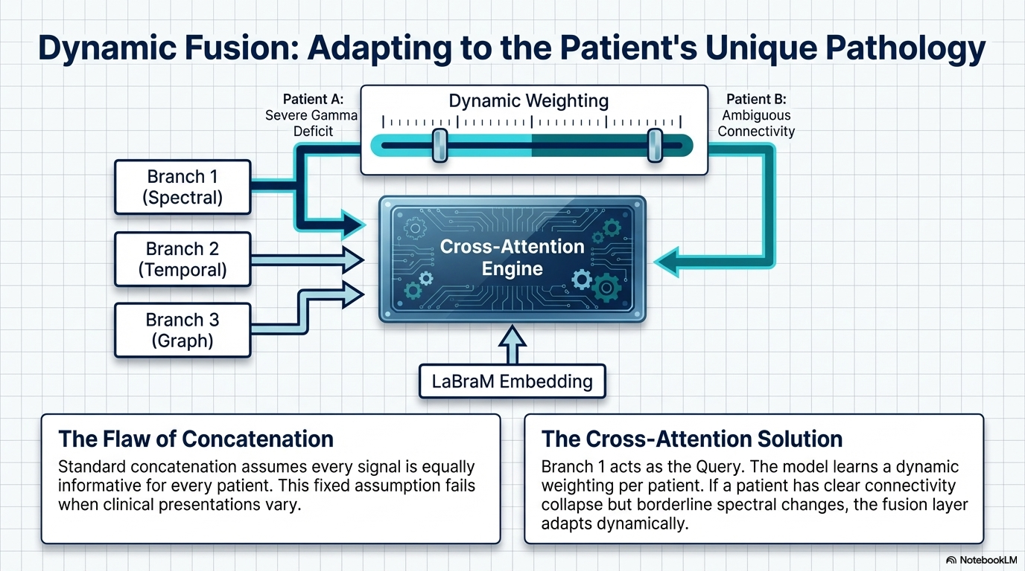

Slide 11


Slide 12
